Slide 1

The Impact of Artificial Intelligence on Different Industries
Exploring Transformations Across Sectors

Slide 2
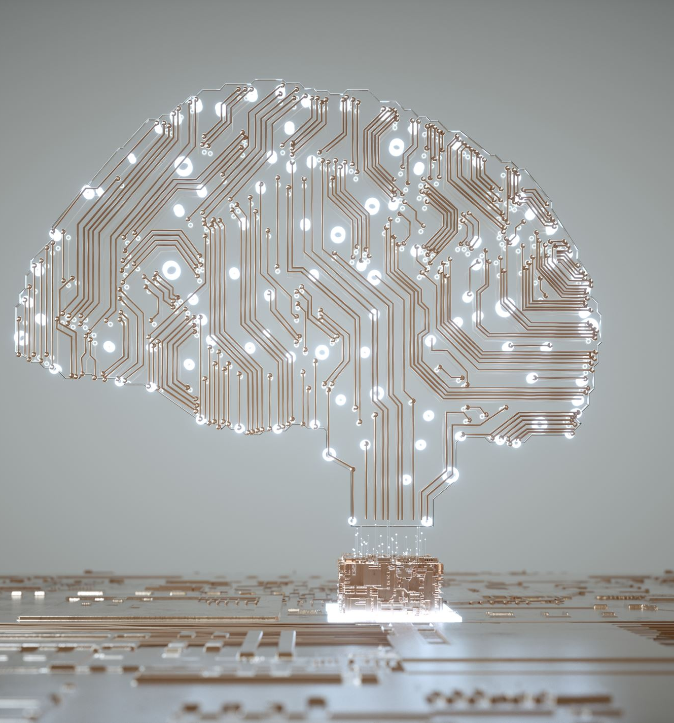
Introduction to Artificial Intelligence
Definition of AI:Artificial Intelligence is the simulation of human intelligence processes by machines, particularly computer systems.Brief History and Evolution:Emerged in the 1950s, with milestones such as the development of expert systems and neural networks.Importance in Today’s World:AI has become integral in various applications, revolutionizing how industries operate.

Slide 3
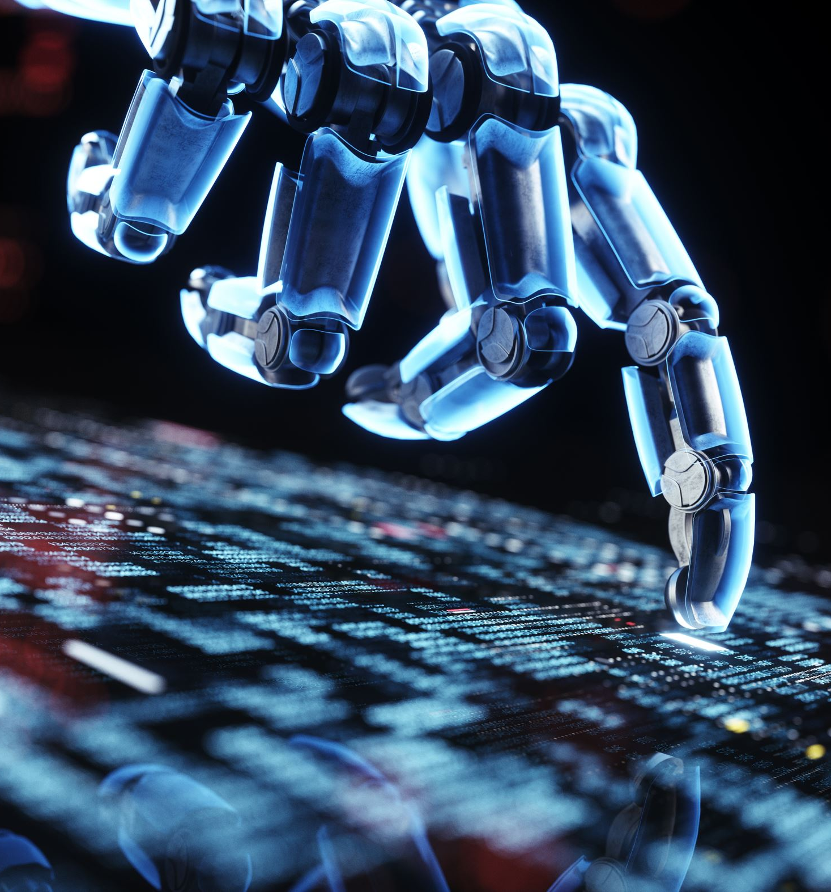
Overview of AI Applications
Types of AI:Narrow AI: Specialized for specific tasks (e.g., voice assistants).General AI: Hypothetical AI that can perform any intellectual task like a human.Machine Learning and Deep Learning:Subsets of AI that enable machines to learn from data.AI in Everyday Technology:Examples include smart home devices, search algorithms, and social media content recommendations.

Slide 4
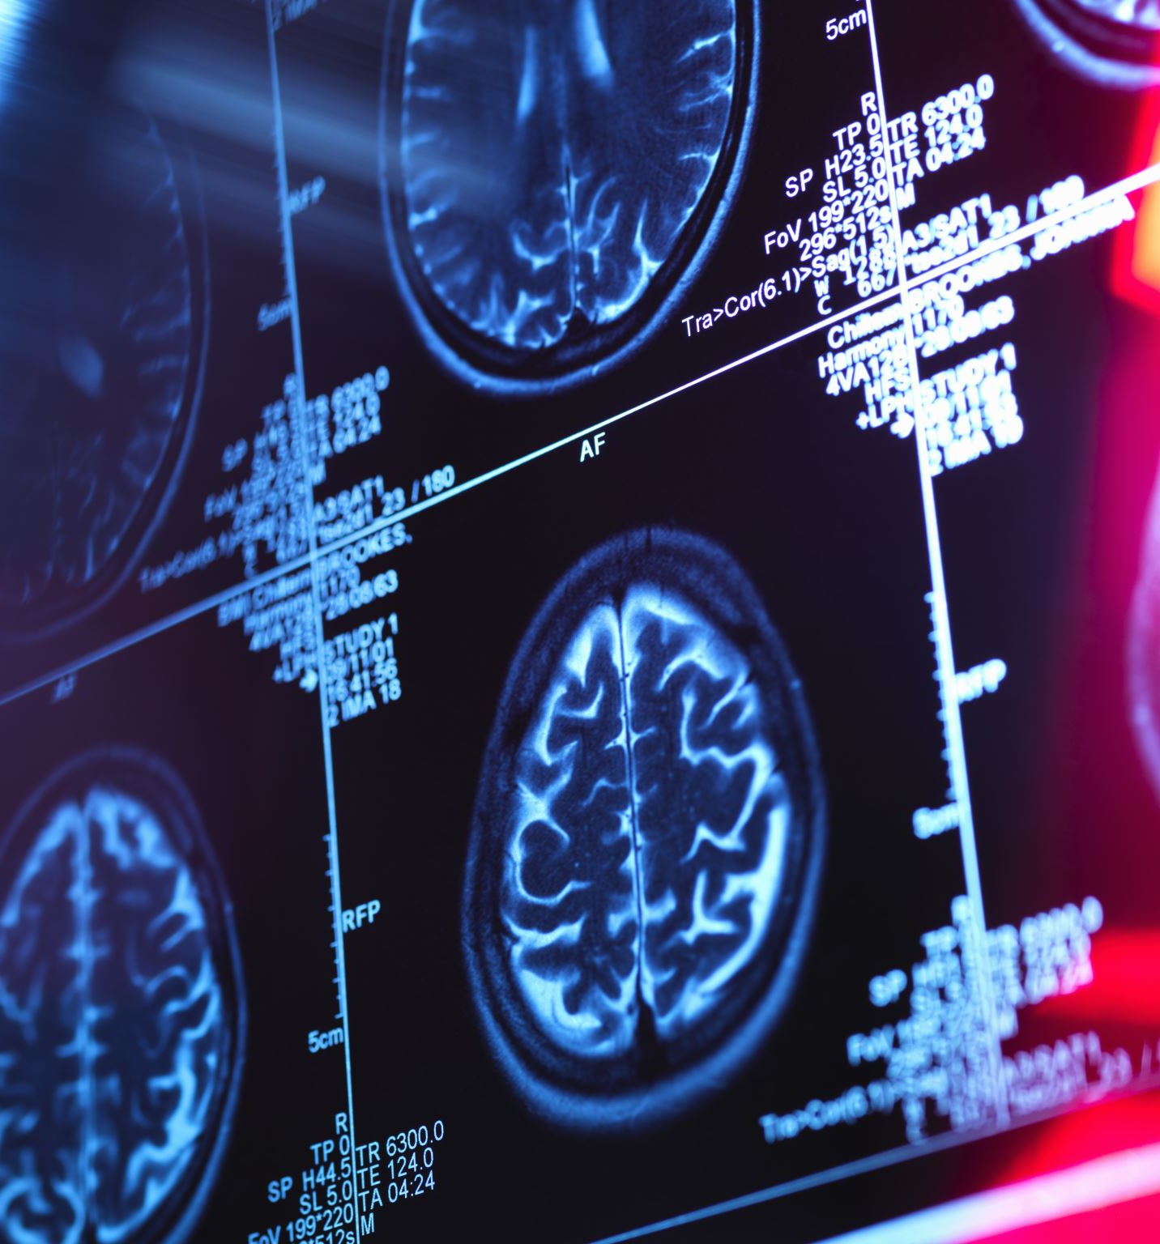
AI in Healthcare
Diagnostics:AI-powered tools can analyze medical images (e.g., X-rays, MRIs) to detect anomalies.Predictive Analytics:Predict patient outcomes and personalize treatment plans based on data trends.Robotic Surgeries:Robots assist surgeons with precision, resulting in less invasive procedures.

Slide 5

AI in Finance
Fraud Detection Systems:AI algorithms identify unusual transaction patterns to prevent fraud.Algorithmic Trading:AI analyzes market data to make real-time trading decisions, increasing efficiency.Chatbots for Customer Service:Provide 24/7 support, handling inquiries and transactions efficiently.

Slide 6

AI in Manufacturing
Automation of Production Lines:Robots perform repetitive tasks, improving speed and reducing human error.Predictive Maintenance:AI analyzes machinery data to predict failures before they occur, reducing downtime.Quality Control:Machine vision systems inspect products for defects more accurately than humans.

Slide 7

AI in Retail
Personalized Shopping Experiences:Recommendation engines suggest products based on browsing history and preferences.Inventory Management:AI predicts demand and manages stock levels, reducing overstock and shortages.Chatbots and Virtual Assistants:Help customers navigate websites and answer queries in real-time.

Slide 8
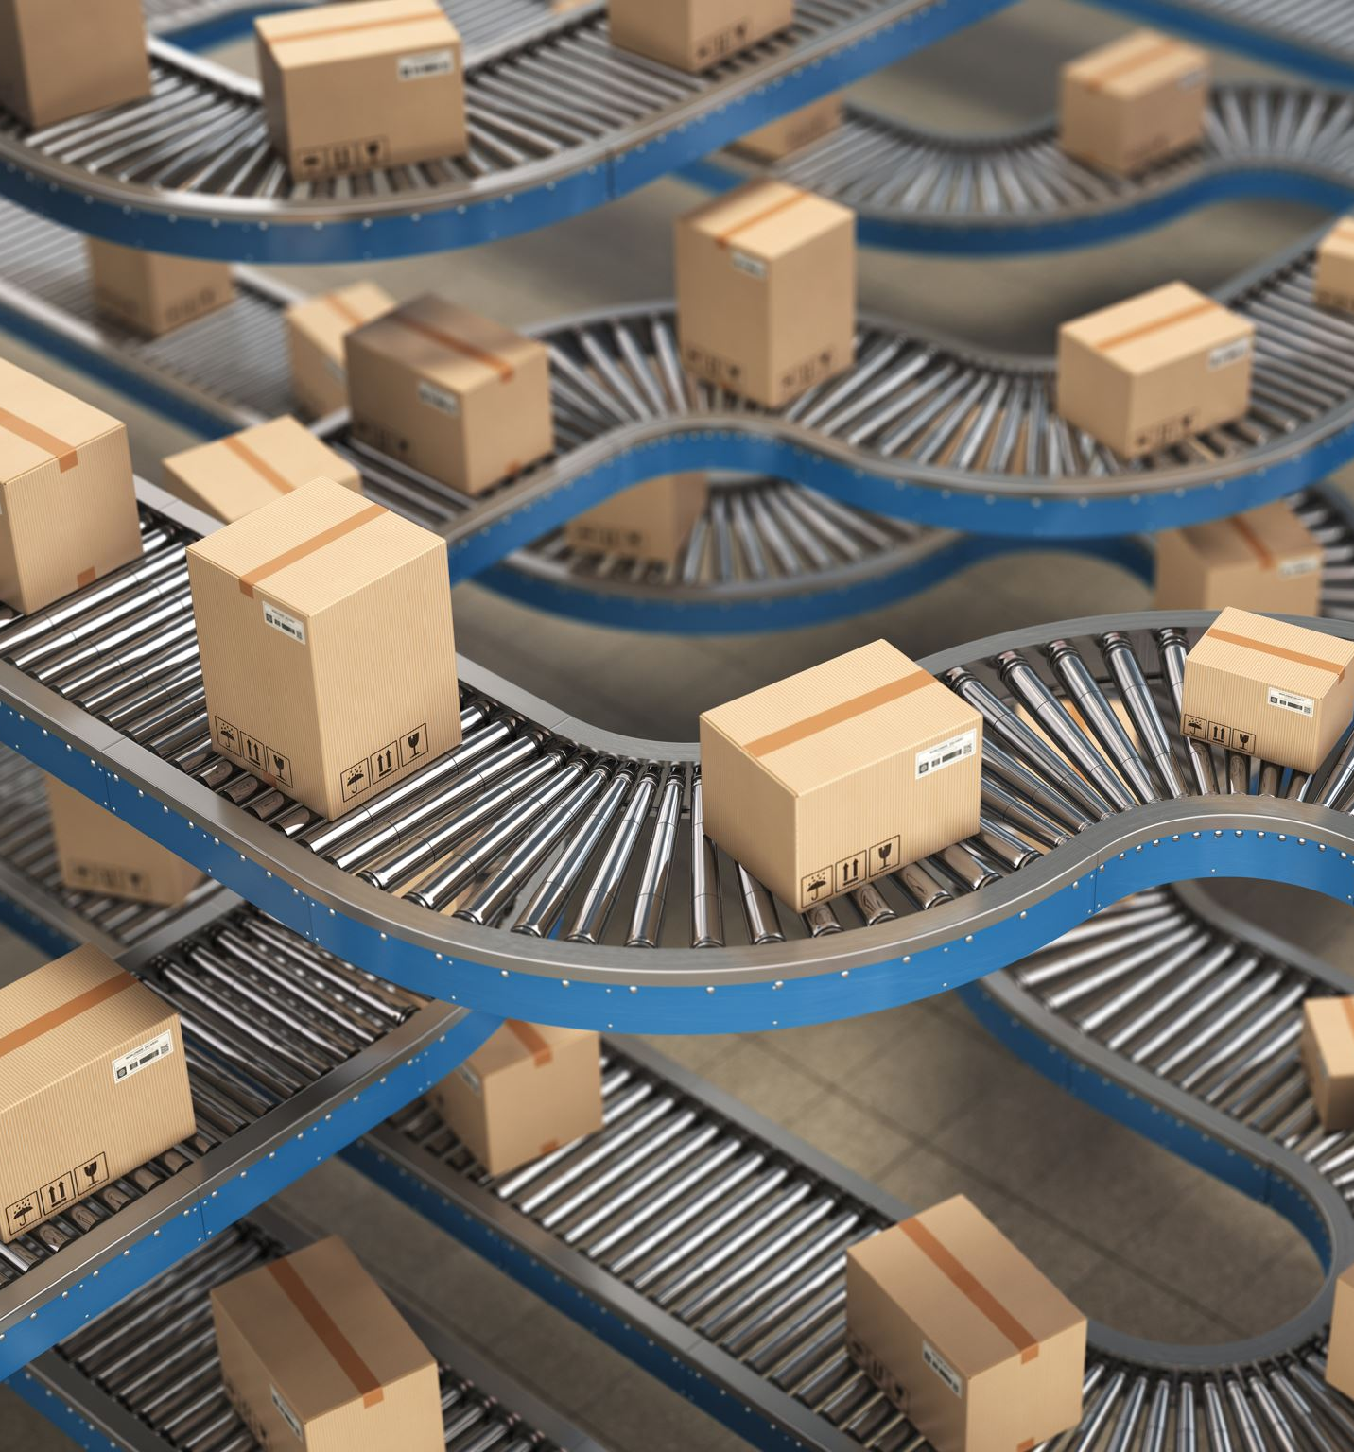
AI in Transportation
Autonomous Vehicles:Self-driving cars use AI to navigate roads and respond to traffic conditions.Traffic Management:AI analyzes traffic patterns to optimize signals and reduce congestion.Logistics and Delivery:AI streamlines routing and scheduling for delivery services.

Slide 9

AI in Education
Personalized Learning:AI adapts learning materials based on student performance and preferences.Administrative Automation:Automates tasks like grading and scheduling, allowing educators to focus on teaching.Data Analytics:Analyzes student performance data to improve curriculum and teaching methods.

Slide 10

AI in Agriculture
Precision Farming:AI analyzes data from sensors and drones to optimize crop yields and reduce waste.Predictive Analytics:Forecasts weather and market trends to assist farmers in planning.Automation in Planting and Harvesting:Autonomous tractors and harvesters increase efficiency and reduce labor costs.

Slide 11

AI in Marketing
Targeted Advertising:AI analyzes consumer behavior to create personalized ad campaigns.Customer Behavior Analysis:Understanding consumer trends through data analytics helps refine marketing strategies.Content Creation:AI tools generate marketing content, improving efficiency.

Slide 12

Challenges and Ethical Considerations
Job Displacement:Automation may lead to job losses in certain sectors; reskilling is essential.Data Privacy:Increased data collection raises concerns about consumer privacy and security.Ethical Dilemmas:Issues such as bias in AI algorithms must be addressed to ensure fairness.

Slide 13
Future Trends in AI
AI and IoT Integration:Smart devices will increasingly leverage AI for enhanced functionality.AI in Emerging Markets:AI adoption will grow in developing countries, addressing local challenges.Predictions for Advancements:Continued advancements in natural language processing, computer vision, and robotics.

Slide 14
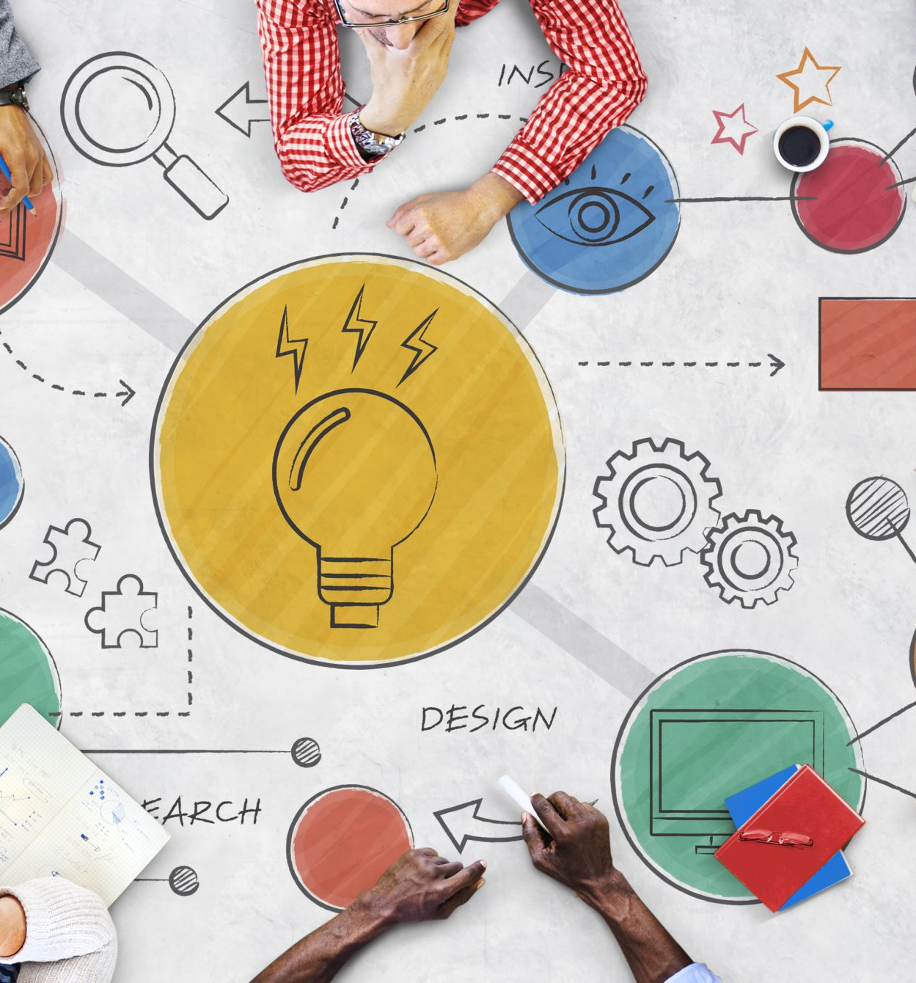
Conclusion
Summary of AI’s Transformative Impact:AI is reshaping industries, improving efficiency, and enhancing experiences.Call to Action:Embrace AI responsibly, focusing on ethical practices and workforce development.Future Outlook:The potential for AI to drive innovation is vast; collaboration across sectors is essential.

